Slide 1
Fuzzy Systems
An Introduction
Dr. Talha Waheed
Dept. of CS, UET, Lahore.

Slide 2
Knowledge Representation in Machine Learning
Performance of machine learning techniques is directly related to the quality of knowledge the system has and can learn from a given problem.
Knowledge is an abstract term that attempts to capture an individual’s understanding of a given subject.

Slide 3
Limitations of Symbolic AI
Review of Classical AI Foundations:
  Propositional & First-Order Predicate Logic function uses binary values.
  Principle of Bivalence: Every statement is strictly True (1) or False (0).
  Law of Excluded Middle: A statement is either a member of a set or its complement. (P OR ¬P) There is no middle ground.
  Law of Contradictions: A proposition (p) and its negation cannot both be true simultaneously. ¬(P AND ¬P)
Where Classical AI Fails in the Real World:
  Hard boundaries lead to 'edge-case explosion' or catastrophic system failures.
  Inability to model semantic uncertainty, sensory noise, and human-like approximations natively.

Slide 4
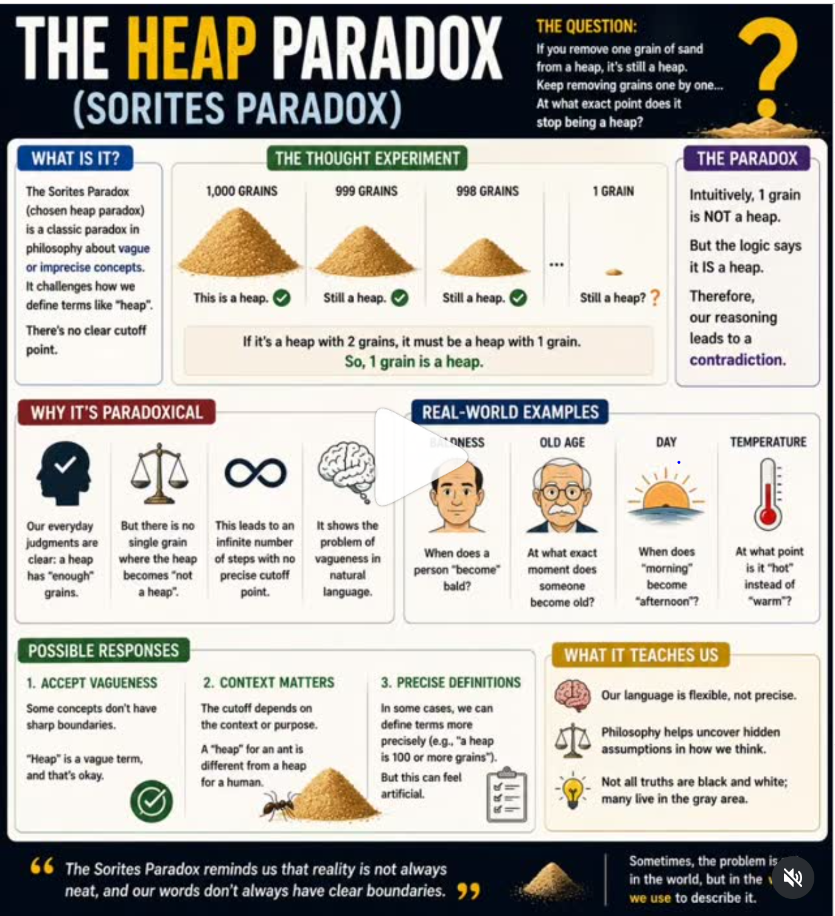
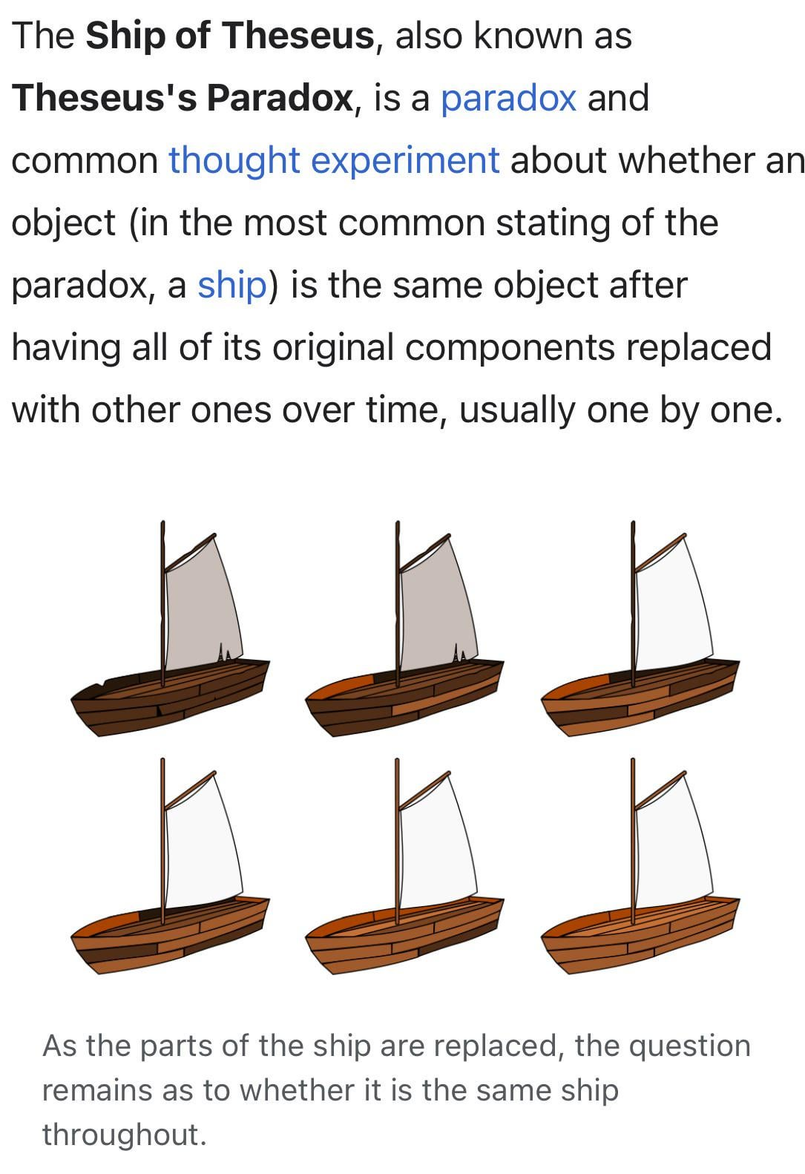
Thomas Hebbs View: Material Identity,
Functional Identity or 4 Dimensionality
Our Biological Identity,
Consciousness,
Organ Replacement

Slide 5
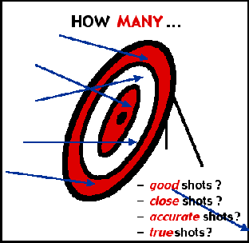
Propositions
Human understanding is mostly based on facts about some event or problem, that are usually represented by Propositions (True/False Statements). E.g.
  It is raining. (Yes/No)
  Color of the chair is brown (True/False)
But our world is vague and uncertain.
(Not black and white.)
We don’t always know if some event is
true or false with complete certainty.

Slide 6
Multi-Valued Logic
Humans have little difficulty in interpreting vague terms.
To represent & reason with vagueness in machines is a challenge.
In Aristotle’s Binary Logic "The train will arrive on time.“ is (T/F)
Whereas In Multi-Valued Logic:
Lukasiewicz Logic: (T:1, Intermediate/Possible:0.5, F:0)
Kleene Logic: (T:1, Undefined/Unknown:0.5, F:0)
Belnap’s 4 valued Logic: (T:1, F:0, Neither T or F, Both T and F)
Godel’s Logic: Intermediate Truth{0,….,1},[False:0,True:1]
Fuzzy Logic:[0-1], 0.7 means train is "mostly on time," perhaps only 2 minutes late

Slide 7
Fuzzy Logic – Formal Definition
A branch of logic that uses degree of membership in the whole range of [0-1] in sets rather than a strict true/false membership{0,1}.
It is used to quantify and reason about vague or fuzzy terms that appear in natural language. (referred as Fuzzy or Linguistic Variables.)
Fuzzy Variable | Fuzzy Value
Temperature | Hot, Cold
Height | Short, Medium, Tall
Speed | Slow, Creeping, Fast
Age | Child, Young, Mid-Age, Old

Slide 8
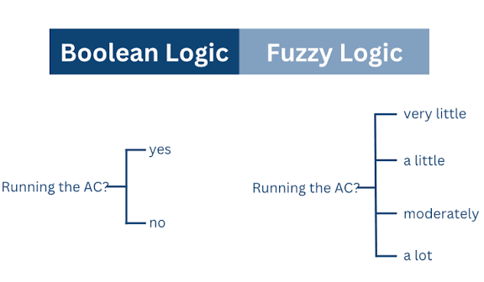
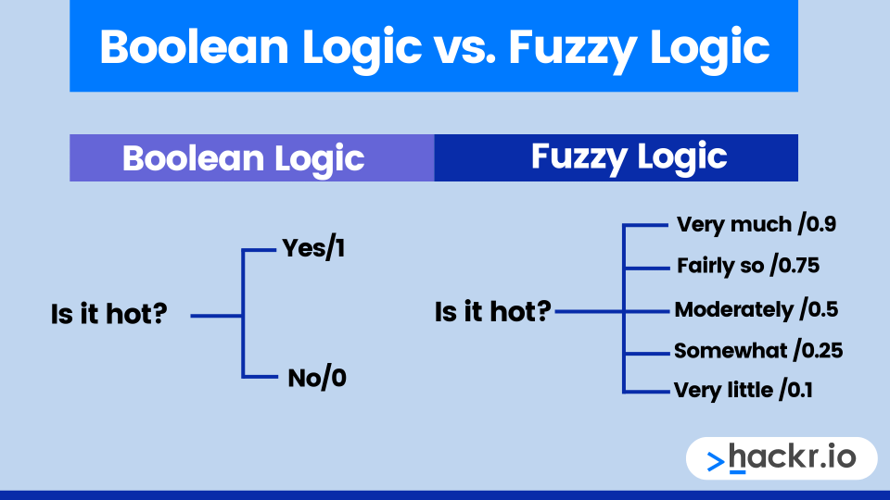

Slide 9
Fuzzy Rules Are Everywhere
If (Speed is Slow) Then
Make the Acceleration High
If (Temperature is Low AND Pressure is Medium) Then
Make Speed Very Slow
A Fuzzy Rule is a conditional statement in the form
IF x is A THEN
y is B
(where x, y are linguistic variables and
A,B are linguistic values determined by fuzzy sets
on the universe of discourses X and Y respectively

Slide 10
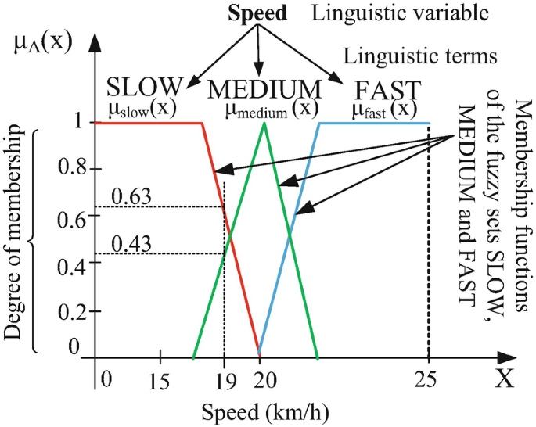
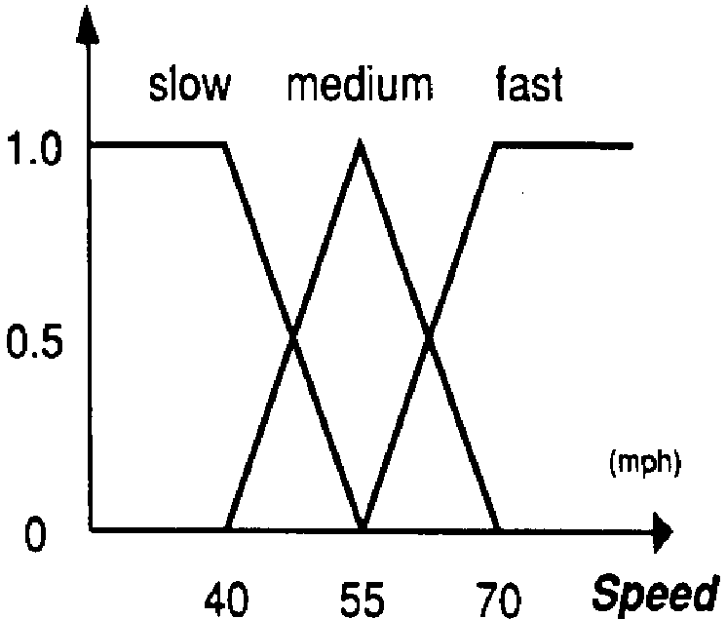

Universe of Discourse
Range of possible values of a linguistic variable is known as Universe of Discourse (a.k.a Domain)
E.g. Domain Values for a Linguistic Variable Speed of a Car (0-180 mph)
Speed is slow occupies a section of Domain, the linguistic term “slow” is known as a fuzzy set.

Slide 11
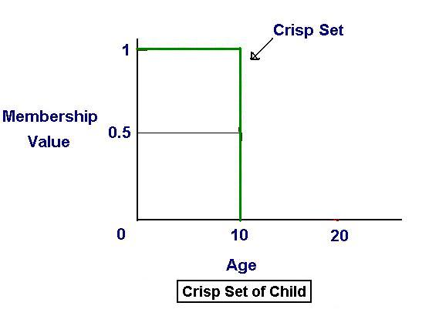
Crisp Logic
Traditional Set Theory views the world as black and white (B/W), (True/False), (Yes/No), (0/1).
E.g. Any one is child if age is less than 10.
On 11th birthday his childhood suddenly vanish?

Slide 12
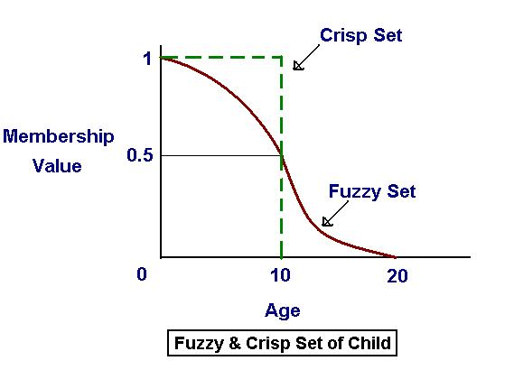
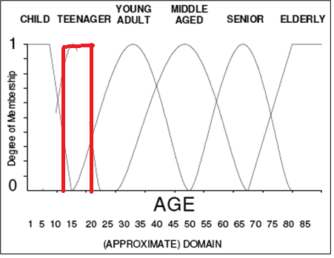
Fuzzy Logic
Fuzzy Logic provides more reasonable interpretation of child. And assigns membership values between [0-1] (graceful transition).
Here Age is a Linguistic Variable and child is one of the Fuzzy Sets.
Other sets may be Teenager, Young Adule, Mid-Age, Senior etc. Each of these sets defined as an Adjective on the linguistic variable.

Slide 13
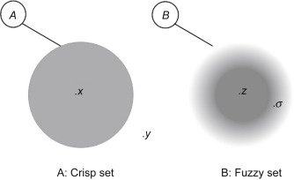
Fuzzy Set – Formal Definition
Let X be the Universe of Discourse with the elements of X denoted as x,
A fuzzy set A of X is characterized by a membership function μ_{A}(x) that
associates each element x with a degree of membership (or belief) in A, a real value (in the range of 0-1).
μ_{A}(x) = Degree(X ∈ A)
Whereas Crisp set is a special case of fuzzy set in which only whole (or boundary) values of 0, 1 can be assigned.

Slide 14
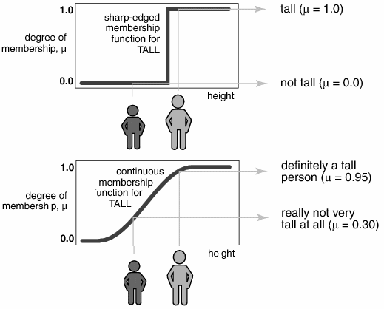
Crisp vs Fuzzy Set of Tall

Slide 15
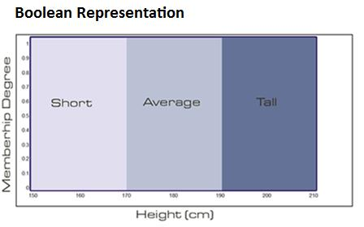
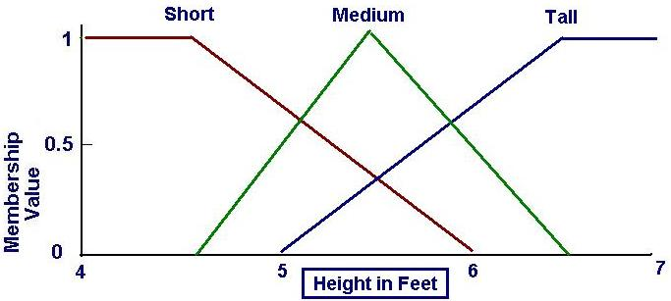
Fuzzy Set Representation
A = (μ₁/x_{1,} μ₂/x_{2,} μ₃/x_{3,} μ₄/x_{4,} μ₅/x₅) is called a Fit-Vector
  Short = (1/4, 1/4.5, 0.7/5, 0.3/5.5, 0/6)
  Medium/Average = (0/4.5, 0.5/5, 1/5.5, 0.5/6, 0/6.5)
  Tall = (0/5, 0.3/5.5, 0.7/6, 1/6.5, 1/7)
Membership Value (or Belief) of 5.5 feet Height (A Fuzzy Variable) in each Fuzzy Set.
μ_{Short}(5.5)=0.3, μ_{Medium}(5.5)=1, μ_{Tall}(5.5)=0.3

Slide 16
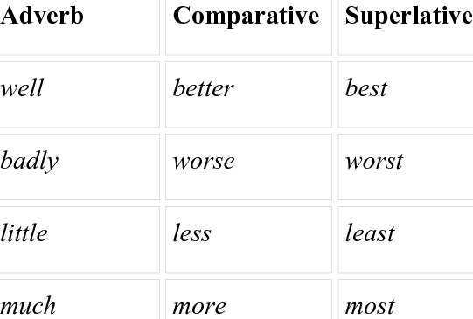
Hedges (Adverbs)
Used For Additional Vagueness
  Very, Slightly, Somewhat
An Adverb is a word that modifies Verb, an Adjective, Another Adverb or a whole sentence. E.g.
  The person is very tall, the person is well built
  Luggage is much heavy
A hedge modifies mathematically an existing fuzzy set to account for some added adverb.

Slide 17
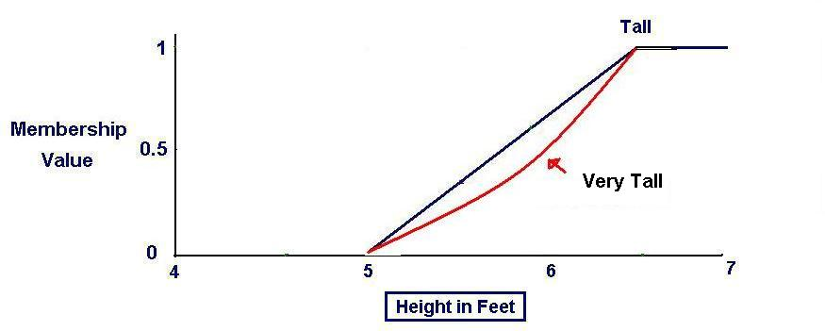
Examples of Hedges 1/3
Concentration (Very)
  To further reduce the membership value,
  μ _{CON(A)}(x) = (μ_{A}(x)) ²
  E.g. At Height 6, membership value decreases
  from μ_{Tall}(6)=0.7 to μ_{VeryTall}(6)=0.49
Power (Very Very): To extend concentration, μ_{POW(A)}(x) = (μ_{A}(x))^{n}

Slide 18
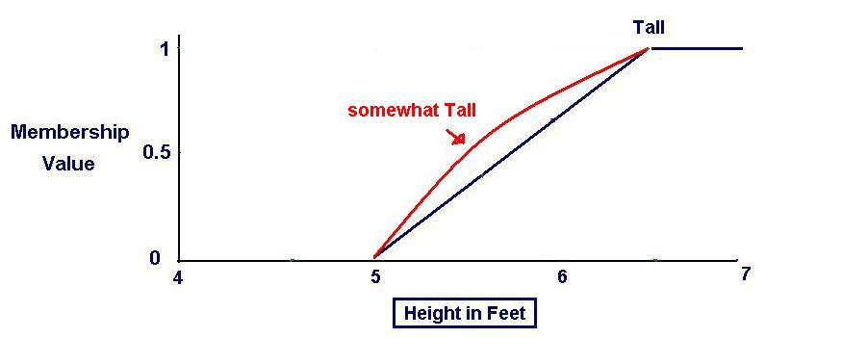
Examples of Hedges 2/3
Dilation (somewhat / More or Less)
  Increases the membership value
  μ_{DIL(A)}(x) = (μ_{A}(x)) ^{0.5}

Slide 19
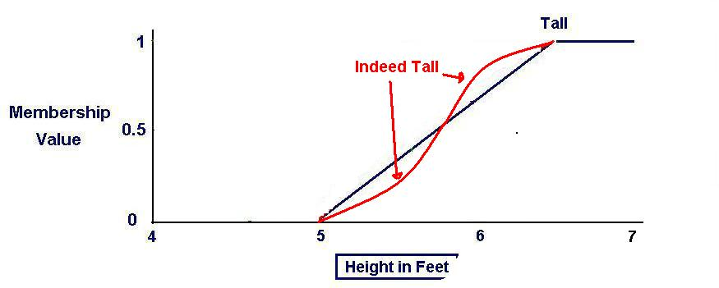
Examples of Hedges 3/3
Intensification(Indeed)
  Intensify the meaning, by increasing the membership values above 0.5 and decreasing those below 0.5
  μ _{INT(A)}(x) = 2(μ_{A}(x)²) for 0 <= μ_{A}(x) <=0.5
  μ_{INT(A)}(x)=1-2 (1 - (μ_{A}(x))^{2,} for 0.5 < μ_{A}(x) <= 1

Slide 20
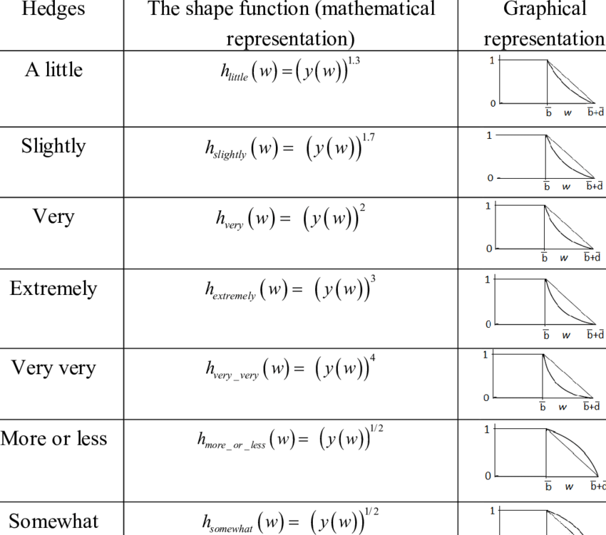
Some Common Hedges

Slide 21
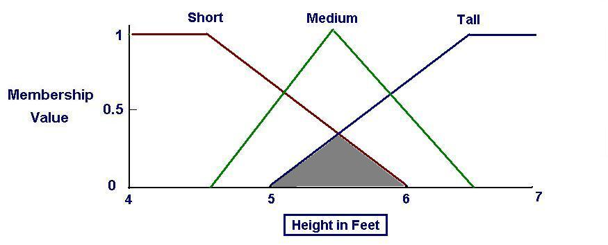
Fuzzy Set Operations 1/4
Intersection
μ_{A}(x) ∩ μ_{B}(x) = min(μ_{A}(x), μ_{B}(x))

Slide 22
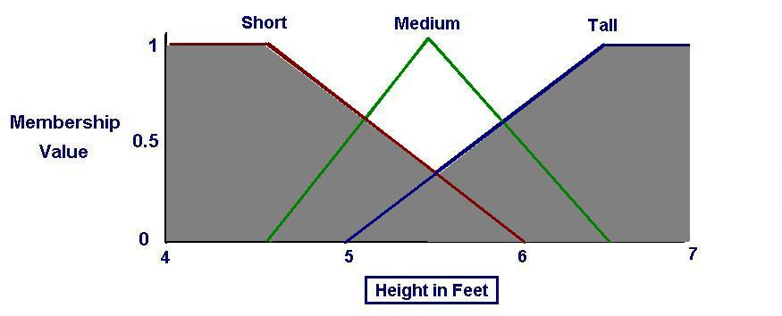
Fuzzy Set Operations 2/4
Union
μ_{A}(x) ∪ μ_{B}(x) = max(μ_{A}(x), μ_{B}(x))

Slide 23
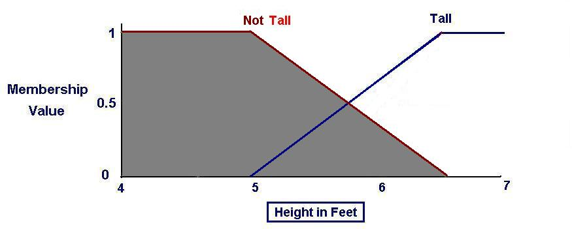
Fuzzy Set Operations 3/4
Complementation (Not)
μ_{Not}(x) = 1 - μ_{A}(x)

Slide 24
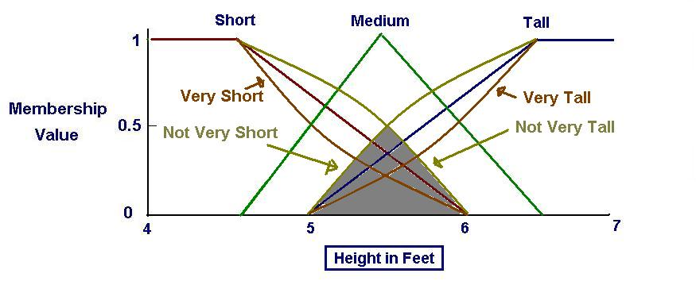
Fuzzy Set Operations 1/4
Complicated:
  Not Very Tall AND Not Very Short
  (1-(μ_{tall}(x)²) AND (1-(μ_{short}(x)²)

Slide 25
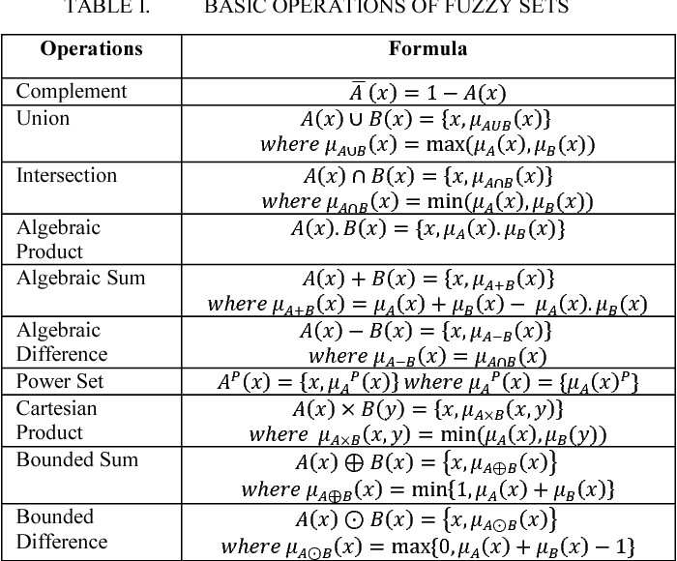

Slide 26
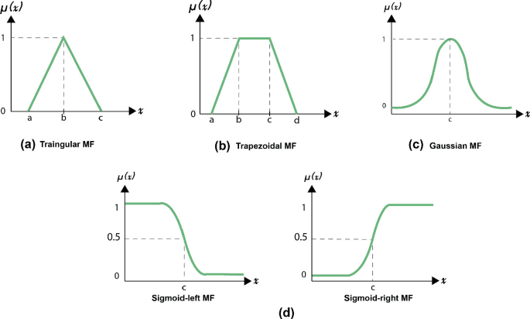
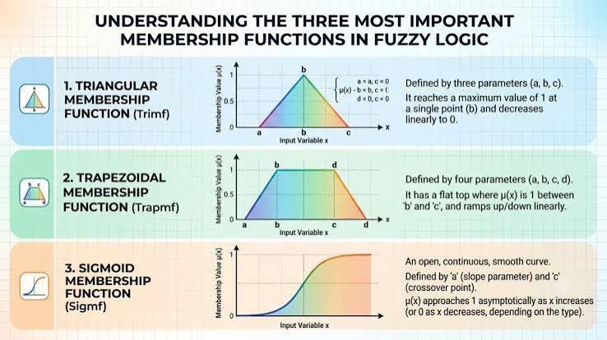
Types of
Fuzzy
Membership
Functions

Slide 27
Fuzzy Inferencing Process
Fuzzy Propositions: X(Fuzzy Variable is A(Fuzzy Value)
Fuzzy Rule relates two propositions, If X is A then Y is B
If Temperature is Normal then Velocity is Medium
If Height is Tall then Weight is Heavy
Fuzzy Assosiative Matrix/Memory (FAM)
Maps Fuzzy Set A to Fuzzy Set B for Fuzzy Inference Process

Slide 28
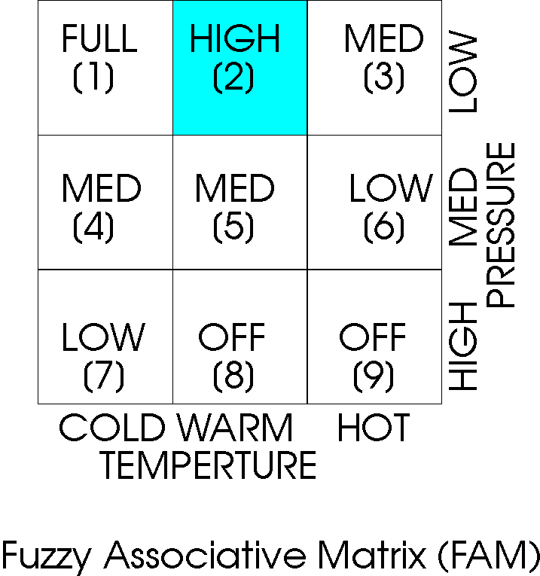
[2]
If Temperature is warm and Pressure is low then set Heat to high
Fuzzy Associative Matrix - Example

Slide 29
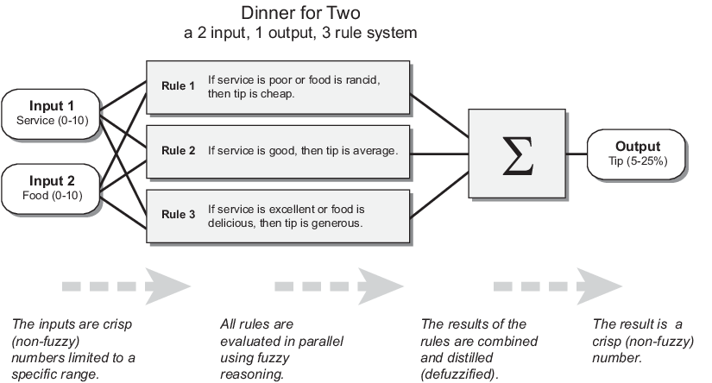
Example – Fuzzy Inference Process
takes service and food quality as inputs and computes a tip percentage using the following 3 rules
https://www.mathworks.com/help/fuzzy/fuzzy-inference-process.html#doc_center_content

Slide 30
Example – Fuzzy Inference System
Fuzzy inference system for this tip calculation problem takes service and food quality as inputs and computes a tip percentage using the following rules.
Rules
If the service is poor or the food is rancid, then tip is cheap.
If the service is good, then tip is average.
If the service is excellent or the food is delicious, then tip is generous.

Slide 31
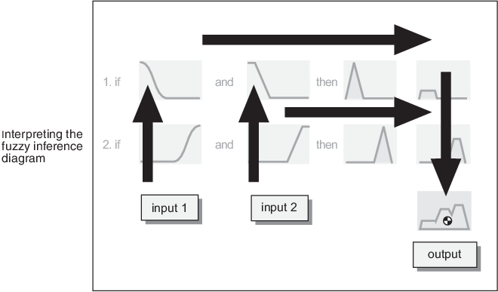
Steps in Fuzzy Inference Process
Fuzzification of the input variables (Service, Food, Tip)
Application of the fuzzy operator (AND or OR) in the antecedent
Implication from the antecedent to the consequent
Aggregation of the consequents across the rules
Defuzzification (Getting Numerical Value)

Slide 32
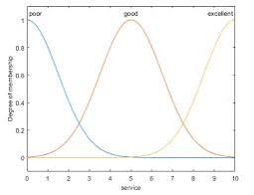
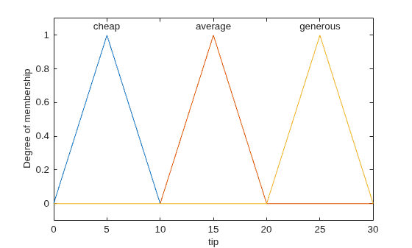
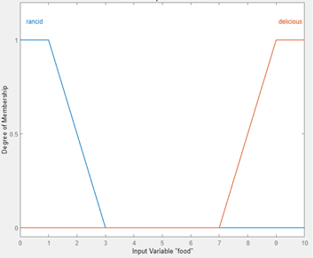
1. Fuzzify Input Variables
Service Fuzzy Set: Sigmoid [?]
Food Fuzzy Set: Trapezoidal[?]
Tip Fuzzy Set: Triangular[?]

Slide 33
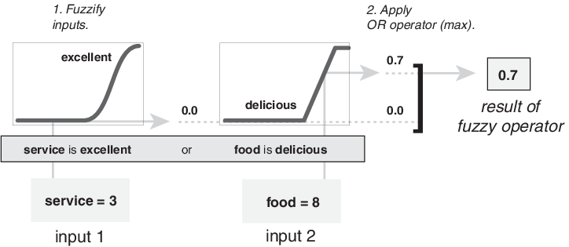
2 - Apply Fuzzy Operators in Antecedent
The fuzzy OR operator selects the maximum of the two values, max(0, 0.7) = 0.7.

Slide 34
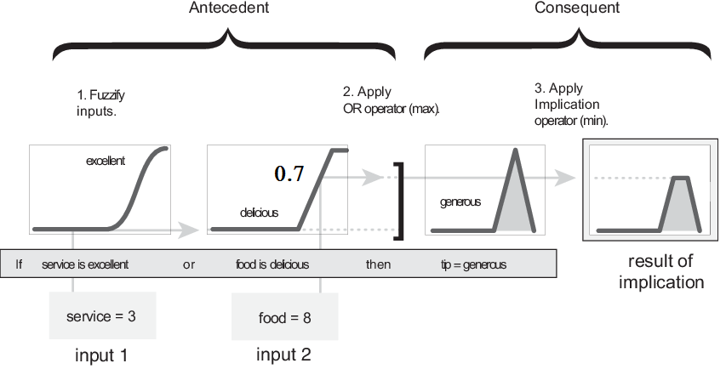
3. Implication from the antecedent to the consequent
If the service is excellent OR the food is delicious, then tip is generous

Slide 35
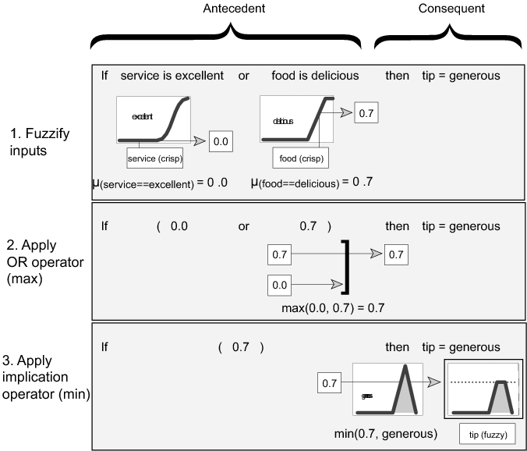
3– Apply Implication Method

Slide 36
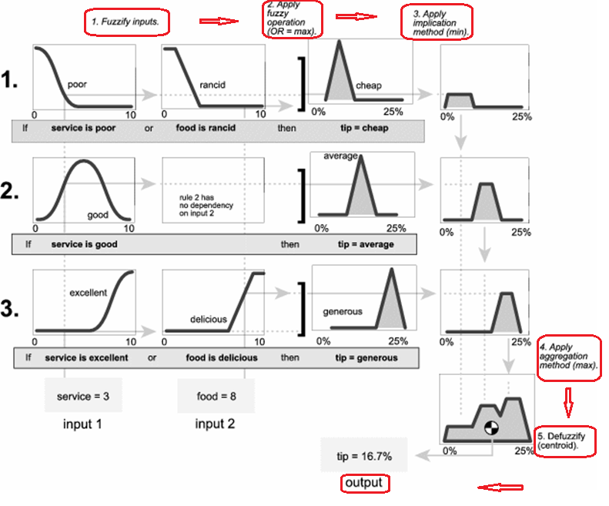
4-Aggregate All Consequences Outputs
5-Take Centroid to Defuzzify

Slide 37
Fuzzy Logic & Knowledge Representation
Fuzzy Logic provides a relatively flexible framework for dealing with human knowledge,
potential to produce models that are more comprehensible, less complex, and more robust;
In data mining, fuzzy methods appear to be especially useful for representing vague patterns and rules,
Fuzzy logic, in conjunction with possibility theory, can contribute to the modeling and processing of various forms of uncertain and incomplete information.
Fuzzy methods appear to be particularly useful for data pre- and postprocessing, in any ML technique.
Courtesy: Eyke Hullermeier, Fuzzy Methods in Machine Learning and Data Mining: Status and Prospects. Fuzzy Sets and Systems

Slide 38
Conclusion - Fuzzy Logic in AI
Humans perform better when they are able to intepret and gain meaning, understanding and information from the training data. This is when they can generalize best and draw the best conclusions.
For human interaction, knowledge acquisition and for modelling the problems with uncertain and vague data Fuzzy Logic seems better
ML algorithms however have no such requirements and can apply techniques to obtain results approaching the probabilistic optimum without any need to comprehend anything.
In these problems Fuzzification and Defuzzification will be an overhead.
There exists hybrid models, but use of Fuzzy Logic in Machine Learning is less explored yet.

Slide 39
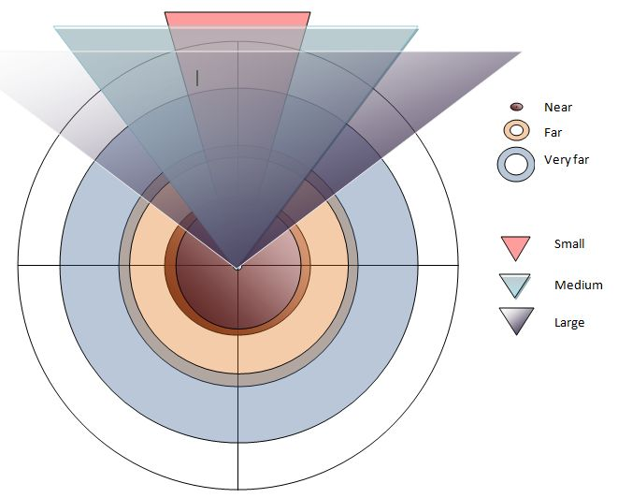
Fuzzy Questions? (If Any)

